Slide 1
Instructions & Information.
Application was built using Visual Studio 2013.
It uses Jquery, AngularJS and Bootstrap files which are already part of the project. Visual Studio will download these packages when compiling for the first time.
The latest version of Typescript (1.4) is also used in this project. You can get that if need here
Open the “565_Project2.sln” file found in the 565_Project2 folder to see the source code.
After compiling the application hit F5 to launch it.
For any questions, contact me at mmanzano@asu.edu

Slide 2
HTTP Request Mapping
Grade obtained from outside appeal API
Get Grade (GET)
Create Appeal (POST)
Get Appeal (GET)
Appeal API takes care of POST,GET,PUT,DELETE via the AppealController.cs file
Abort Appeal (DELETE)
Update Appeal (PUT)

Slide 3
Resource Transition Diagram
Case 1: Happy
Case 2: Abandoned
Case 3: Forgotten
Case 4: Bad Start
Case 5: Bad Id
Get Grade
Get Grade
Get Grade
Get Grade
Get Grade
Create Appeal (POST)
Create Appeal (POST)
Create Appeal (POST)
Create Appeal (POST, wrong URI)
Create Appeal (POST)
Professor Looks at Appeal (GET)
Decide to abandon Appeal (PUT)
Professor Looks at Appeal (GET)
Error Reported
Professor Looks at Appeal (GET)
Student Checks Appeal (GET)
Professor Approve Appeal (PUT)
System removes abandoned(DELETE)
Student attempt to check appeal but forgets id(GET)
No Update so Student follows up (PUT)
Student Sees Appeal (GET)
Error reported (couldn’t find appeal)

Slide 4
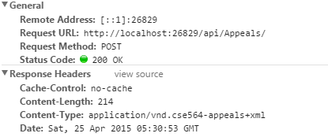
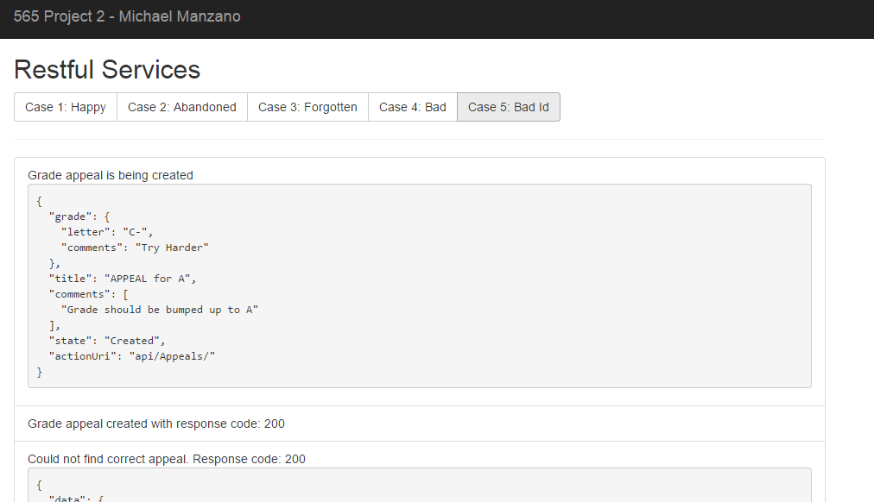
Screenshots
Response code after creating appeals .

